Slide 1
NUTRITION AGENT PROJECT
Presented By:
Atulya Utkarsh, Shiv Nadar Institute of Eminence, B.Tech CSE

Slide 2
OUTLINE
Problem Statement
Proposed System/Solution
System Development Approach (Technology Used)
Algorithm & Deployment
Result (Output Image)
Conclusion
Future Scope
References

Slide 3
Problem Statement
In an era where health awareness is growing, individuals increasingly seek personalized nutrition guidance. However, most existing tools provide generic diet plans, lack real-time adaptability, and fail to consider a person's holistic lifestyle, cultural preferences, allergies, and evolving health conditions. Furthermore, dieticians and nutritionists face limitations in scaling personalized consultations due to time and resource constraints.

Slide 4
Proposed Solution
Generative AI presents a groundbreaking opportunity to revolutionize this space by enabling an intelligent, interactive, and adaptive virtual nutrition assistant. By leveraging natural language processing (NLP), multimodal understanding, and large-scale dietary databases, an AI-powered assistant can generate dynamic meal plans, recommend smart food swaps, and explain nutritional choices—all tailored to the individual.

Slide 5
System Approach
This project aims to develop “The Smartest AI Nutrition Assistant” using state-of-the-art generative AI
models that:
• Understand user inputs via text, voice, or image (e.g., food photos, grocery labels)
• Generate personalized meal plans based on health goals, medical conditions, fitness routines,
and preferences
• Offer contextual explanations (e.g., “Why is this food better?”)
• Adapt suggestions dynamically with continuous feedback
By integrating health data, food databases, and LLM-powered reasoning, the solution will bridge the gap between one-size-fits-all diet apps and in-person nutrition counselling—delivering an AI that thinks, learns, and cares like a real nutrition expert.

Slide 6
Algorithm & Deployment
Data Input:
The model takes a variety of input related to the user, such as age, gender, food preferences, goals, weight and height
Training Process:
The model is trained on data from several health studies over the internet which gives it a large amount of data for people of all ages to make predictions accurately.
Prediction Process:
The model analyzes the training data to accurately predict a suitable training plan for the user.

Slide 7
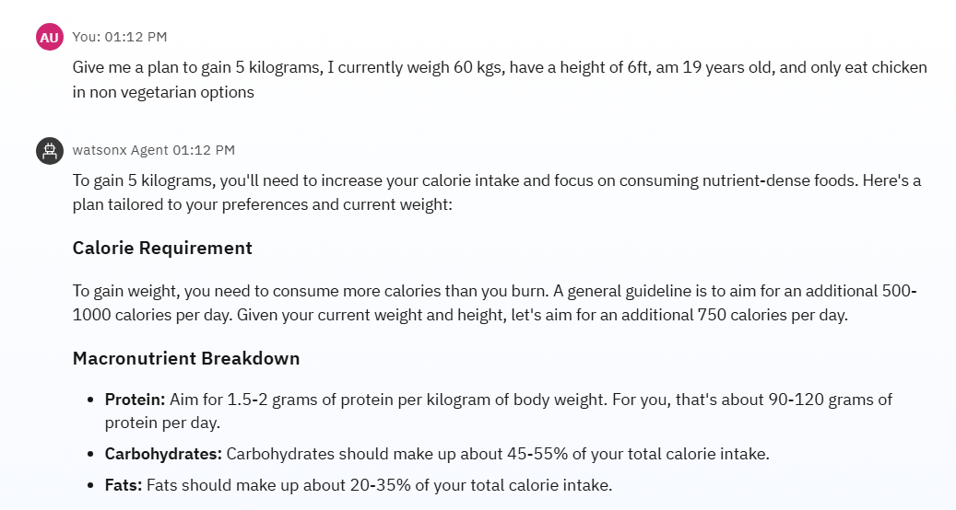
Result

Slide 8
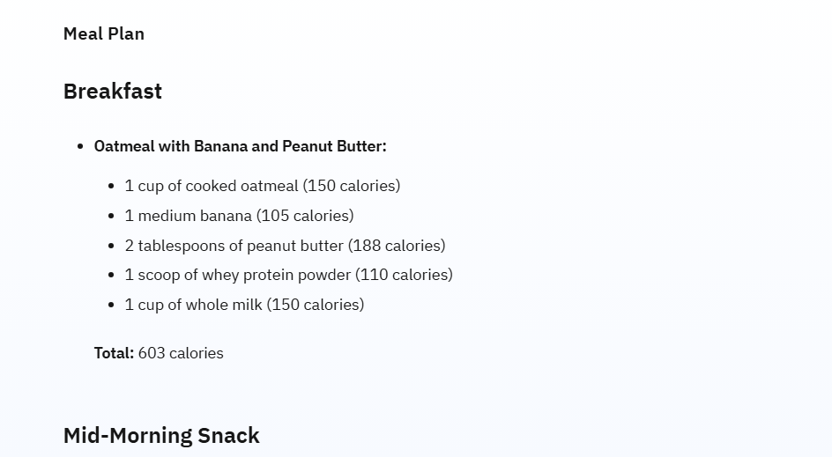
Result

Slide 9
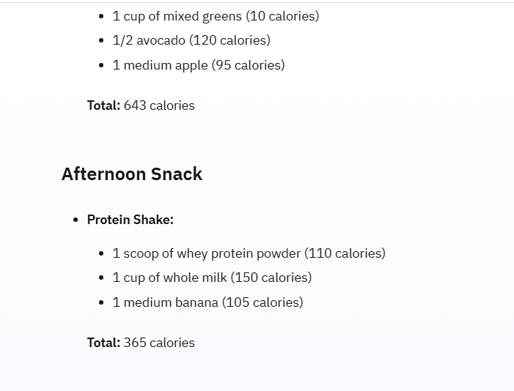
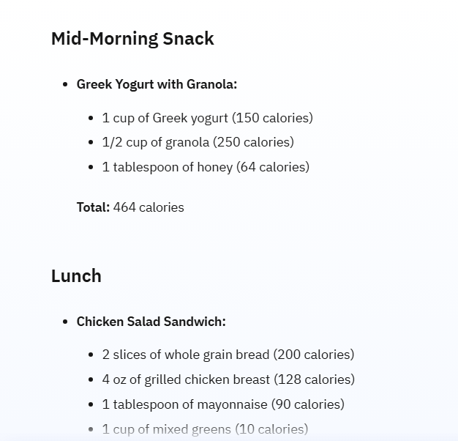
Result

Slide 10
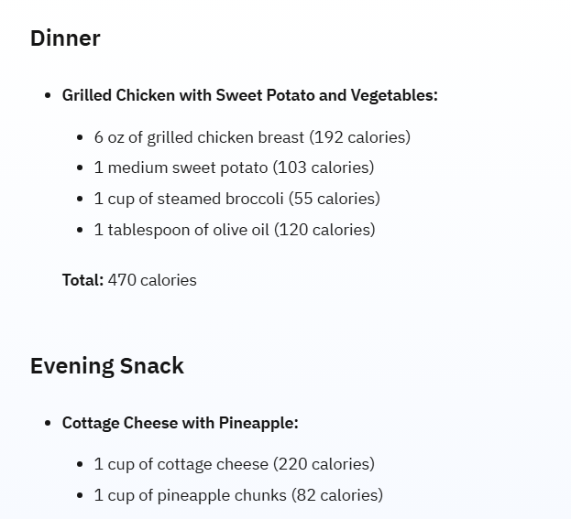
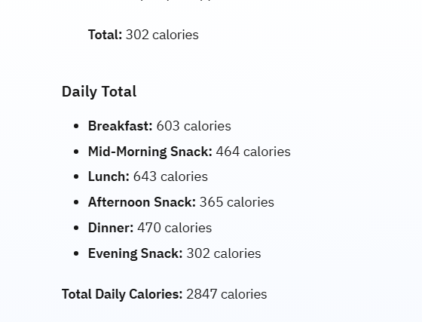
Result

Slide 11
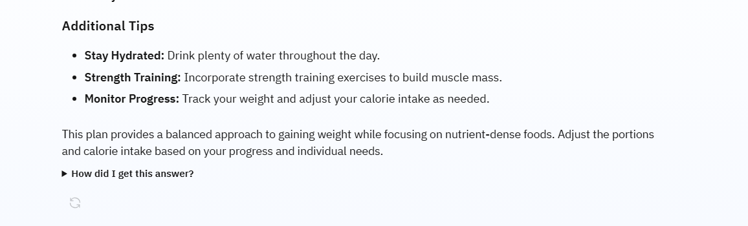
Result

Slide 12
Conclusion
The development of the nutrition AI agent showcased both the potential and practicality of leveraging intelligent systems to support healthy decision-making. Through personalized guidance, real-time analysis, and accessible recommendations, the agent demonstrated strong effectiveness in improving user awareness of dietary choices and fostering sustainable nutrition habits.

Slide 13
Future scope
The agent should integrate local nutrition databases, cultural dietary norms, and user feedback for enriched personalization. Edge computing should be utilized to deploy lightweight inference models on mobile/IoT devices for faster, offline recommendations and reduced latency.

Slide 14
References
USDA FoodData Central: A comprehensive U.S. government database offering detailed food composition data, including branded foods, legacy datasets, and nutrient profiles.
FooDB: A rich resource for food compound data, linking chemical properties, biological activities, and health effects across multiple databases.
IBM cloud tutorials.
https://github.com/Atulya12Utkarsh/IBM-skillsbuild (GitHub repository)

Slide 15
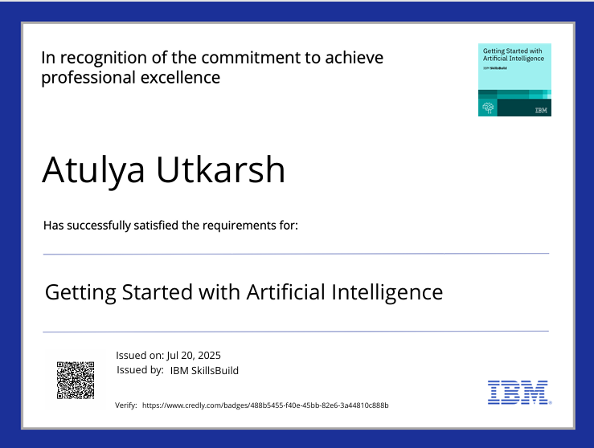
IBM Certifications

Slide 16
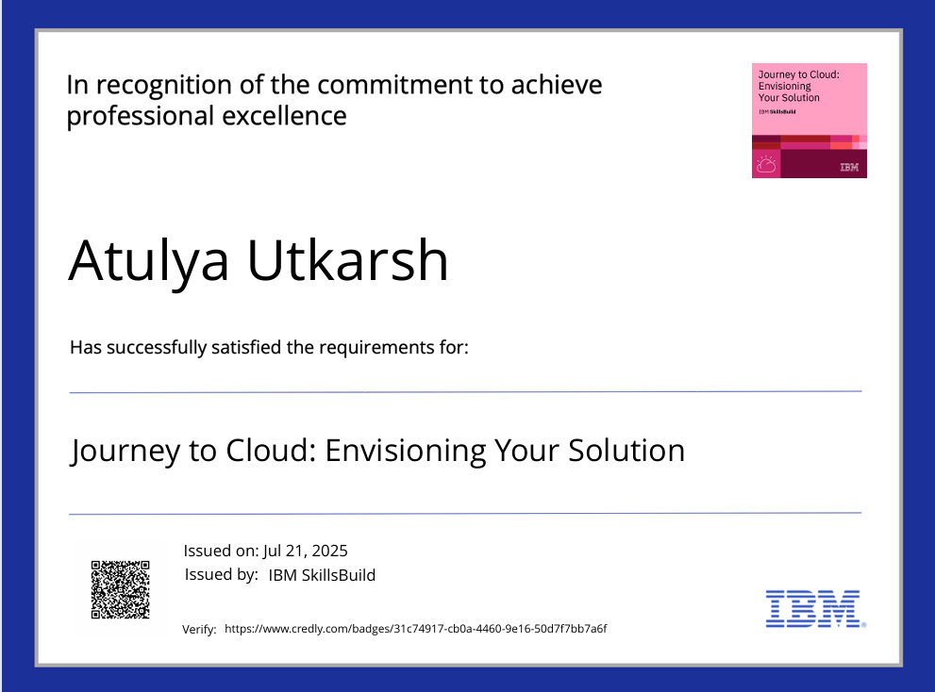
IBM Certifications

Slide 17
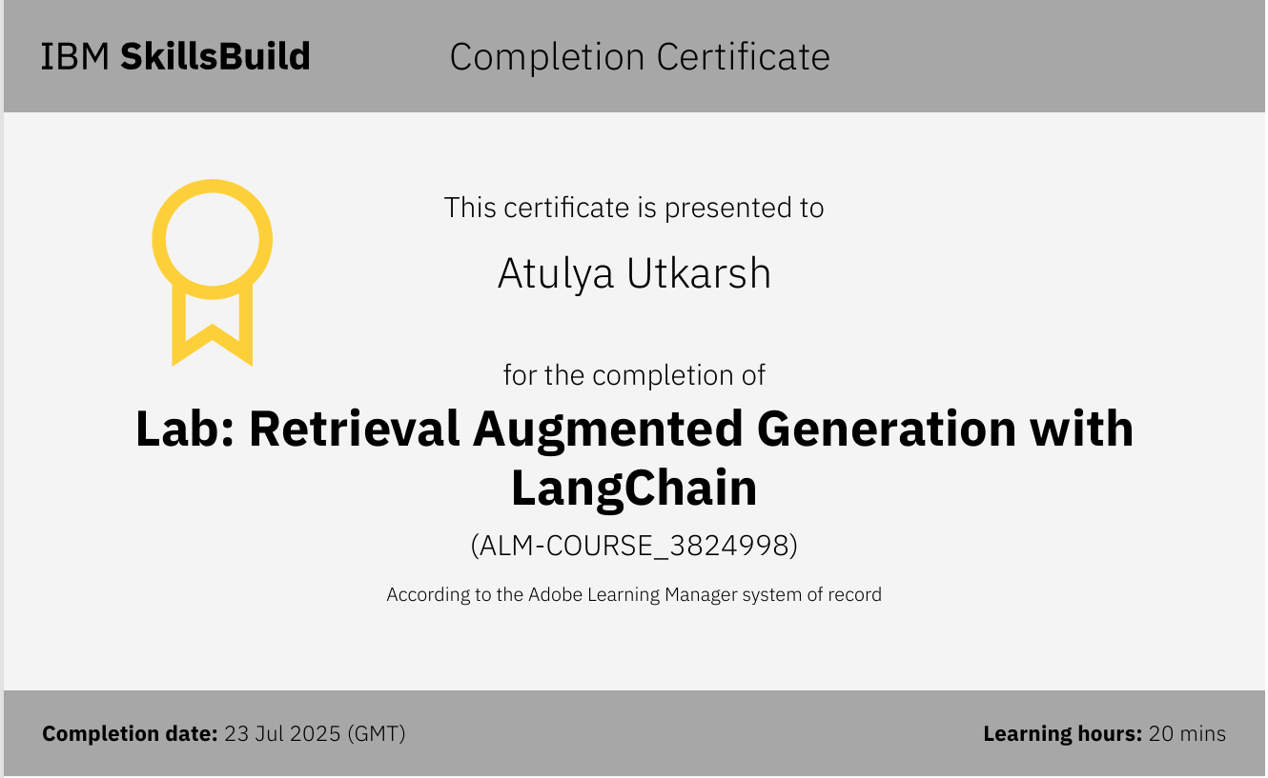
IBM Certifications

Slide 18
THANK YOU

